Slide 1

Chapter 1
Getting Started with HTML

Slide 2
Learning Objectives
How a Web browser downloads and processes an HTML page for display
What is the purpose of a Web server
How to use a text editor to create your own HTML file
Why browsers, when displaying an HTML file’s content, will ignore spacing such as tabs and carriage returns
What Web development software programs you may want to use to simplify the process of creating webpages
What are the common tags that developers place within HTML files
How to display the HTML tags for a site you are viewing within a browser
What the purpose of a domain name is and how to get your own
How to test the webpages you create within all of the common browsers because not all browsers behave the same way—

Slide 3
Learning objectives continued
How to view webpages from your own computer
Why you should avoid spaces within your HTML filenames
How to display special symbols within an HTML page
How to view a site’s HTML tags

Slide 4
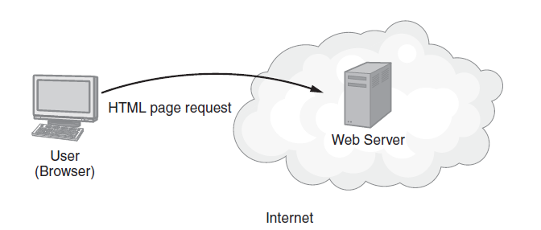
Viewing a Web Page
To display a webpage, a browser requests the page contents from a site’s Web server.

Slide 5
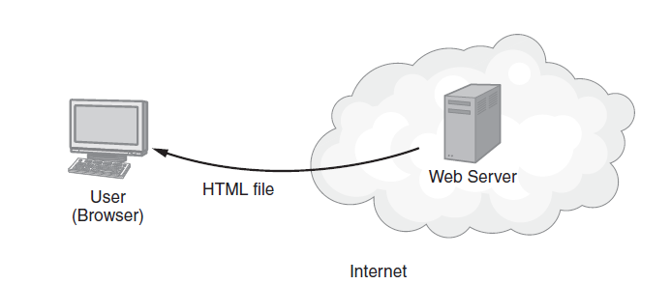
Viewing a Web Page Continued
A Web server listens for requests from Web browsers and then returns the requested file.

Slide 6
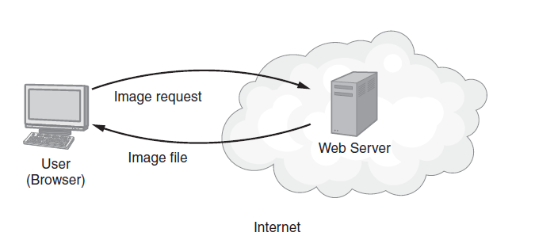
Viewing a Web Page Continued
Most webpages reference content, such as photos, which the browser requests from the Web server.

Slide 7
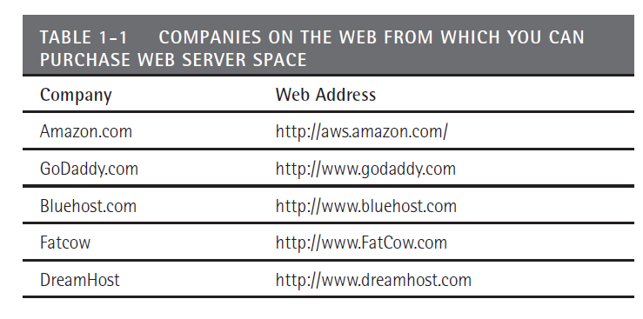
Getting a Web Server
Many sites on the Web provide Web server space which users can buy on a monthly basis

Slide 8
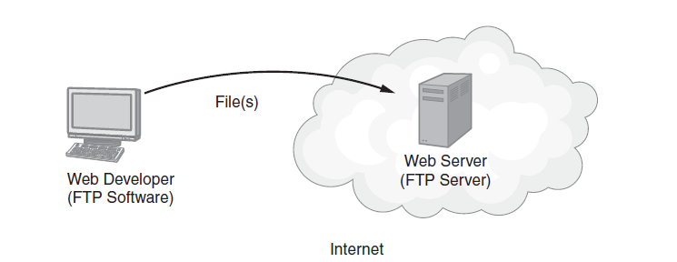
Using FTP to Transfer files
Using FTP software, you will upload the HTML files you create on your system to a remote Web server.

Slide 9
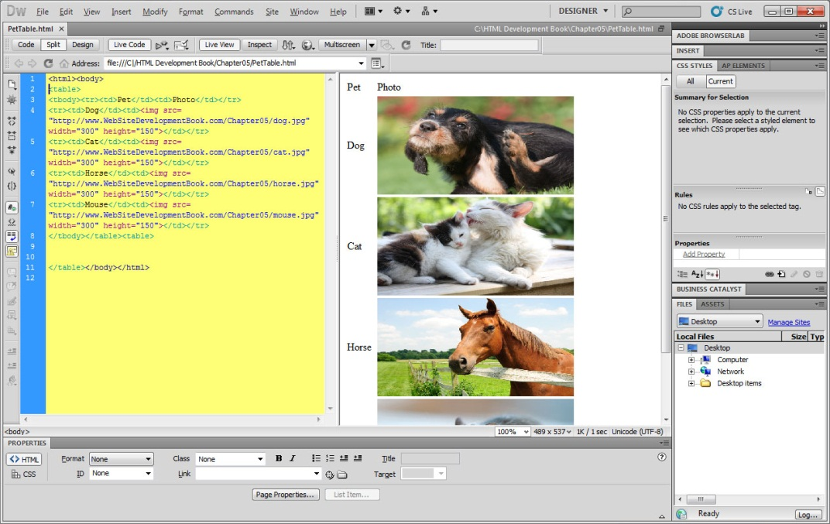
Ways to create HTML files
Users can develop pages using an ASCII text editor or Web development software that provides a drag-and-drop interface such as DreamWeaver

Slide 10
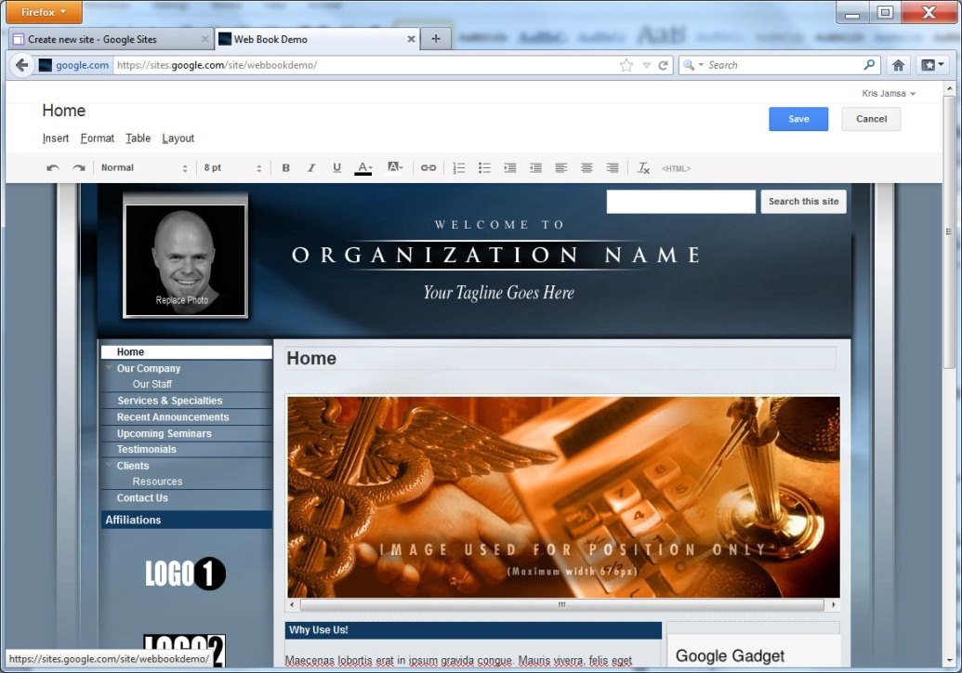
Some sites provide Web-page Templates
Some sites allow users who don’t want to learn HTML with a way to create sites

Slide 11
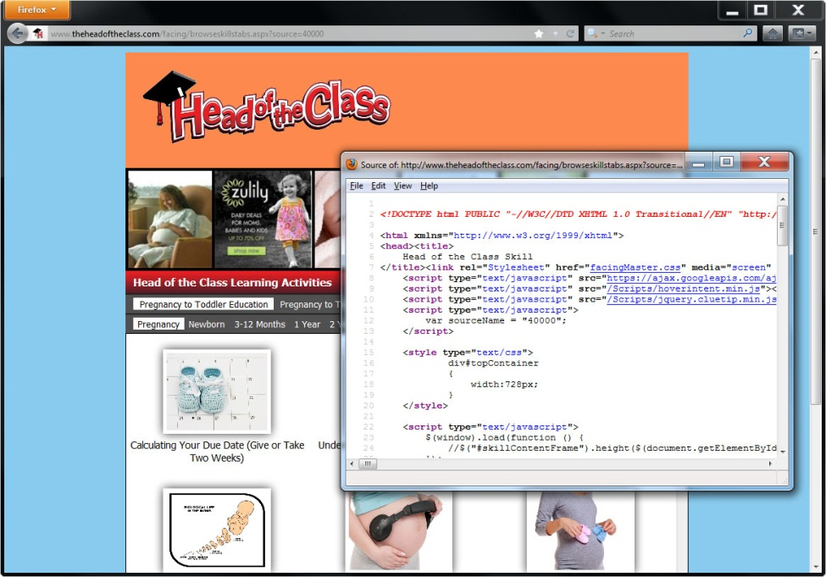
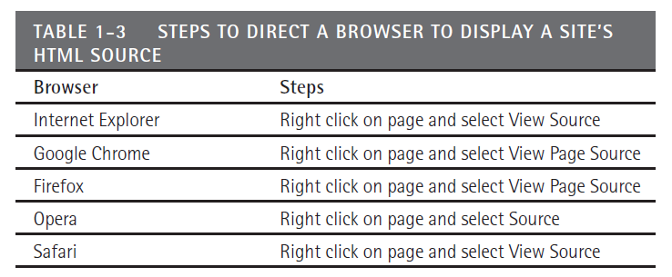
Viewing a site’s HTML tags
As you view sites on the Web within your browser, you can view the site’s underlying HTML tags

Slide 12
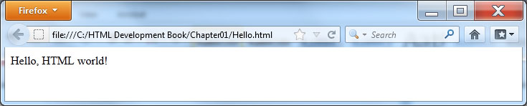
Creating Your Own HTML File
<!DOCTYPE html> <html> <body> Hello, HTML world! </body> </html>
Notes:
Note file:// within the URL
Remember, because the file resides on your computer’s disk, and not on a Web browser, other users cannot view your file.

Slide 13
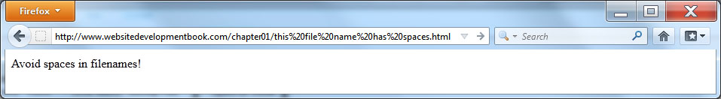
Naming HTML Files
When you name your HTML files, select names that meaningfully describe the file’s contents, such as AboutUs.html or ContactUs.html.
Avoid spaces within your filenames. Browsers will replace the spaces with the characters %20, which may confuse users

Slide 14
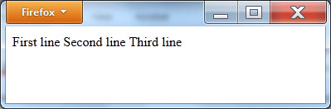
Web Browsers Ignore Spacing and Carriage Returns
<!DOCTYPE html> <html> <body> First line Second line Third line </body> </html>

Slide 15
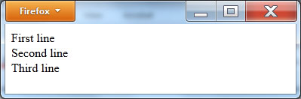
Creating a line break <br/>
<!DOCTYPE html> <html> <body> First line <br/> Second line <br/> Third line <br/> </body> </html>

Slide 16
Use lowercase for html tags
Use lowercase letters for your tags, such as <html> instead of <HTML>, when you create your HTML files
As a general rule, most browsers support lowercase, uppercase, and even mixed cased tags, such as <HTml>.
However, standard documents that provide the HTML specifications lean toward the use of lowercase. In reality, there are likely billions of HTML documents around the Web that use uppercase tags. Browsers simply can’t stop supporting uppercase tags or all of these pages would break.

Slide 17
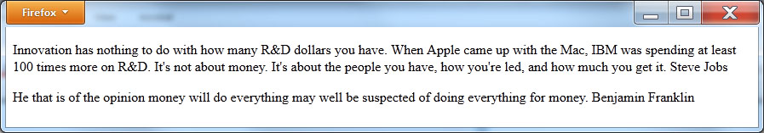
Creating paragraphs
<!DOCTYPE html> <html> <body> <p>Innovation has nothing to do with how many R&D dollars you have. When Apple came up with the Mac, IBM was spending at least 100 times more on R&D. It's not about money. It's about the people you have, how you’re led, and how much you get it. Steve Jobs</p> <p>He that is of the opinion money will do everything may well be suspected of doing everything for money. Benjamin Franklin</p> </body> </html>

Slide 18
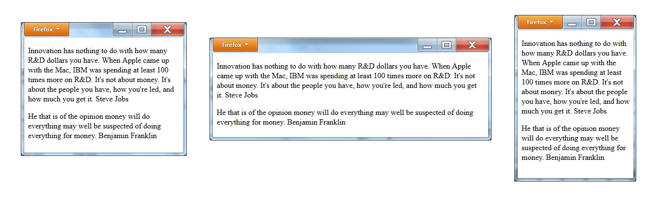
Browsers will adjust paragraphs based on the window size

Slide 19
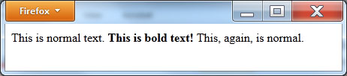
Displaying bold text
<!DOCTYPE html> <html> <body> This is normal text. <b>This is bold text!</b> This, again, is normal. </body> </html>

Slide 20
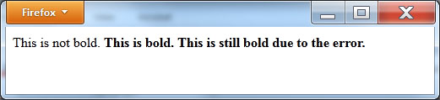
Forgetting a Stop Tag
<!DOCTYPE html> <html> <body> This is not bold. <b>This is bold.<b> This is still bold due to the error. </body> </html>

Slide 21
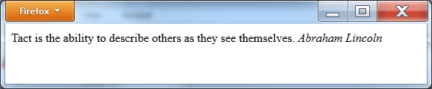
Displaying italic text
<!DOCTYPE html> <html> <body> Tact is the ability to describe others as they see themselves. <i>Abraham Lincoln</i> </body> </html>

Slide 22
Understanding nested tags
<b><i>This is bold and italic.</i></b>
When you place one set of HTML tags inside of another (also called nesting tags), you need to keep the order of your tags consistent. Meaning, you should close the innermost tag first. In the previous statement, the code first closes the italic tags (the innermost tags) and then the bold tag.

Slide 23
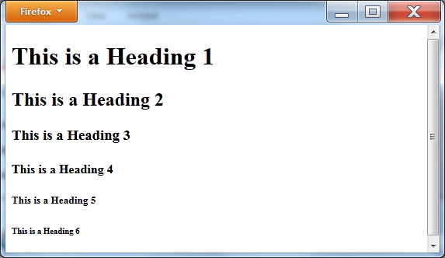
Headings h1-h6
<!DOCTYPE html> <html> <body> <h1>This is a Heading 1</h1> <h2>This is a Heading 2</h2> <h3>This is a Heading 3</h3> <h4>This is a Heading 4</h4> <h5>This is a Heading 5</h5> <h6>This is a Heading 6</h6> </body> </html>

Slide 24
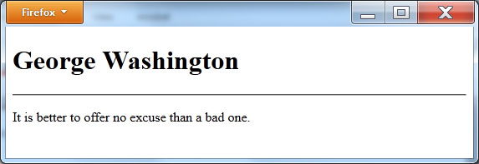
Displaying a horizontal rule <hr/>
<!DOCTYPE html> <html> <body> <h1>George Washington</h1> <hr/> <p>It is better to offer no excuse than a bad one.</p> </body> </html>

Slide 25
Understanding Deprecated Tags
Since the introduction of HTML in the late 1980s, different HTML tags have come and gone. When a tag is replaced by a newer tag or formatting capability, the older tag is said to be deprecated.
You should avoid the use of deprecated tags within the files that you create. Although it is unlikely, it is possible that a browser might stop supporting a deprecated tag.
In reality, given there are millions of pages that use such tags, it is doubtful that a browser would not support the tags, which would essentially break the corresponding pages.
As you use different tags, note whether or not the tag is deprecated. Normally, a deprecated tag is your indication that there is a better way to accomplish the same result.

Slide 26
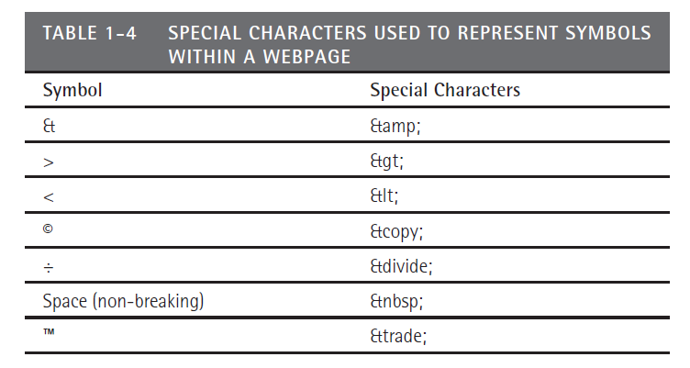
Using Special Characters

Slide 27
Placing Comments within HTML Files
<!-- This is a comment -->
When a browser examines your HTML code, the browser will simply ignore the comment text. It will not display the text.

Slide 28
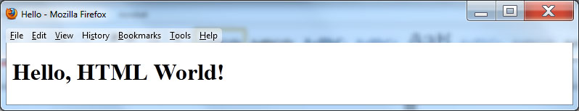
Displaying a page title
<!DOCTYPE html> <html> <head> <title>Hello</title> <body> <h1>Hello, HTML World!</h1> </body> </html>

Slide 29
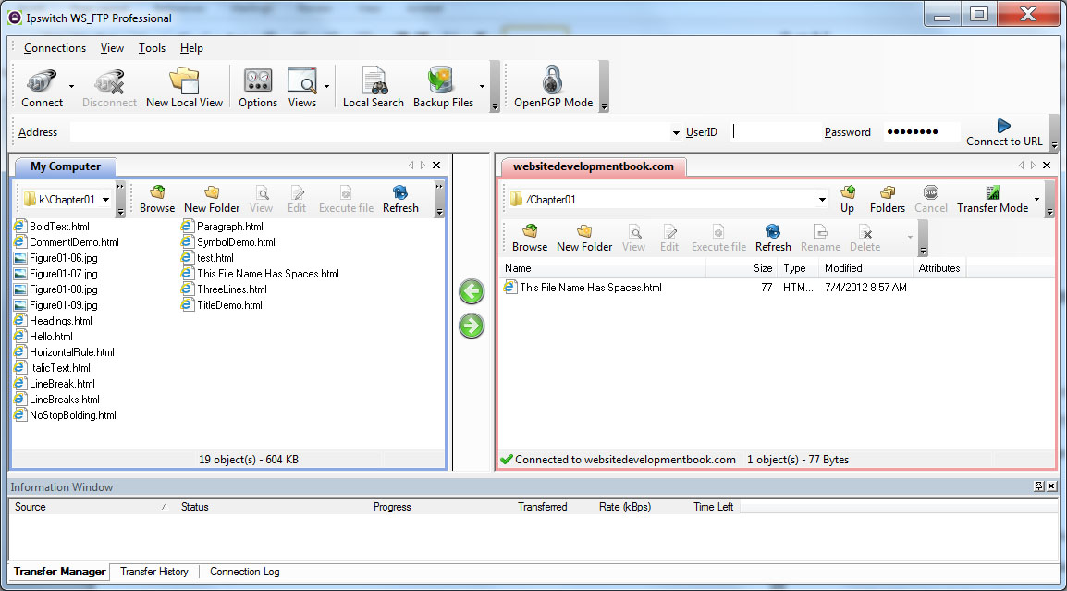
Using FTP to upload files to a web server

Slide 30
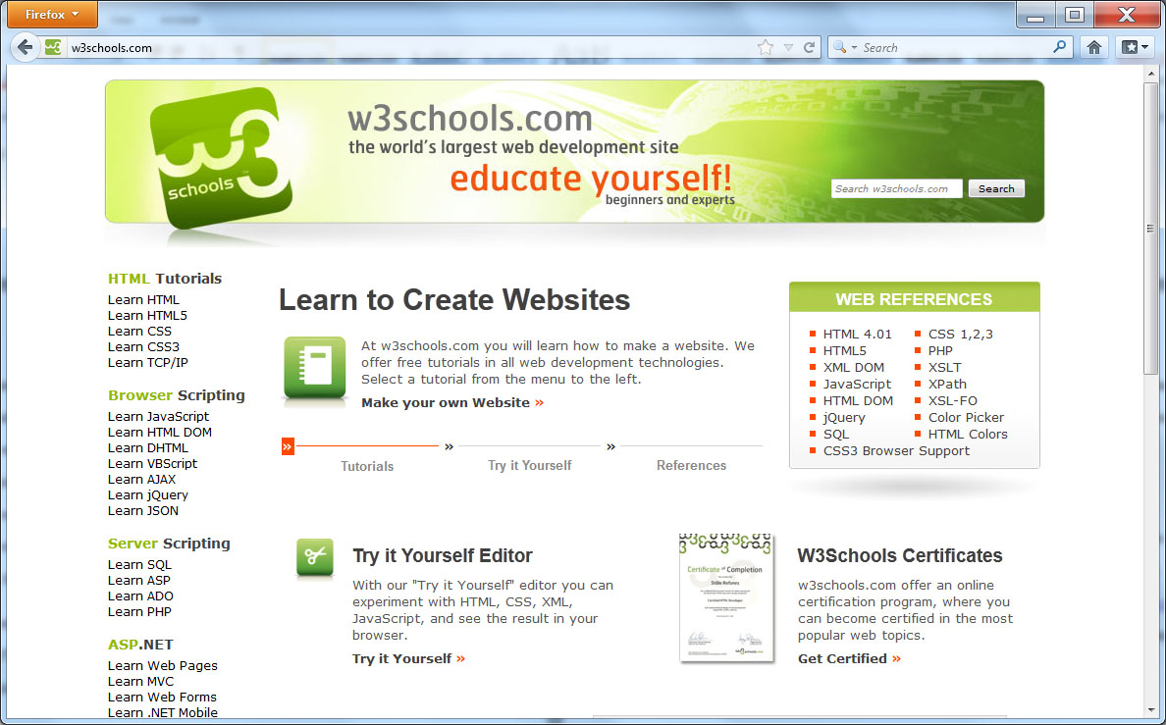
Real World Web Design—w3Schools

Slide 31
Summary
Users make extensive use of Web browsers to view content on the Web.
A browser only knows how to request a file from a remote Web server and then to use the formatting instructions the file contains to retrieve, format, and display the needed content items, such as text, photos, and video.
The pages that users view on the Web are created in HTML. To create webpages, developers use the hypertext markup language (HTML).
HTML uses special markup tags to format content. One set of HTML tags may specify the title that appears in the browser window for the page, another set may specify the text for a paragraph, and another may provide specifics about a photo that is to appear on the page.

